Slide 1
Keyword Extraction App Using TF-IDF
Streamlit Web Application
By: Mohak Bajaj [500093079]

Slide 2
Introduction
Welcome to the Keyword Extraction App Using TF-IDF!
Today, I'll be introducing you to this web application designed for keyword extraction.
Let's explore its features and capabilities for simplifying the keyword extraction process.

Slide 3
Objective
The objective of this project is to develop a user-friendly web application for keyword extraction using TF-IDF.
The app aims to simplify the process of keyword extraction from documents, providing a convenient tool for text analysis tasks.

Slide 4
Technology Stack
Streamlit: Web application development framework
Python Libraries:
NLTK (Natural Language Toolkit)
PyPDF2: For PDF file parsing
python-docx: For DOCX file parsing
python-pptx: For PPTX file parsing
scikit-learn: For TF-IDF vectorization

Slide 5
Features
File upload functionality for various document formats (PDF, DOCX, PPTX, TXT).
Text extraction from uploaded files.
Keyword extraction using TF-IDF algorithm.
Displaying and filtering top keywords.
Downloading extracted keywords as a text file for further analysis.

Slide 6
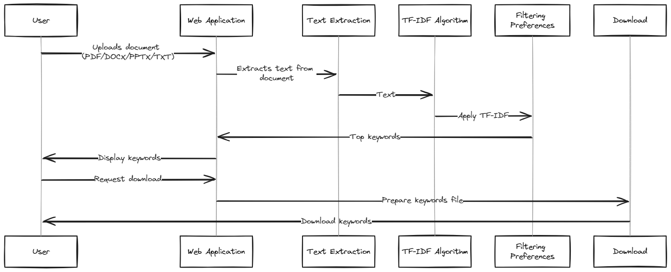
Workflow

Slide 7
Demonstration
Let’s have a look around the application

Slide 8
Thank You!

